Slide 1
Public Library Service in Alberta
A Presentation for Member Councils

Slide 2
Agenda
Introduction
Council’s Role
The Library Board’s Role
Library Service Framework
Public Library Services
Regional Library Systems
Regional Library System Services
Provincial Government’s Role
Recap
Edit footer in the insert tab
9/3/2021

Slide 3
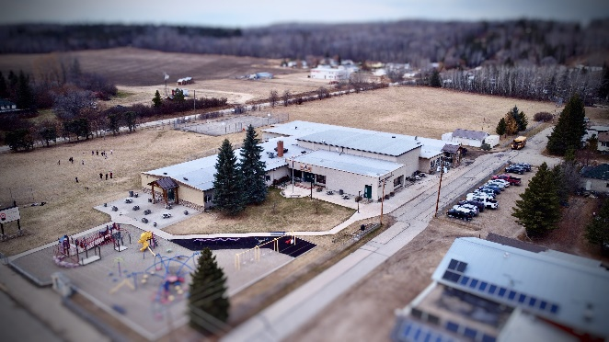
Public Library Service in Alberta
Municipal responsibility.
Defined by the Libraries Act.
Governed solely by the Libraries Act.
Not subject to the Municipal Government Act (MGA).
Edit footer in the insert tab
9/3/2021
Notes:
Public Library Service is a municipal responsibility and is defined in the Libraries Act.
Municipalities may choose to provide the service at the local level, and also at the regional level.
Library services are governed solely by Libraries Act (not subject to MGA).

Slide 4
Council Role #1
Pass bylaw to create a municipal library board.
Appoint the library board, and dismiss if necessary.
Edit footer in the insert tab
9/3/2021

Slide 5
Council Role #2
Adequately fund the library board to provide service.
Accept or disallow the individual who reviews library board’s financial accounts (audit) annually.
Edit footer in the insert tab
9/3/2021
Notes:
Council may only approve the amount of funding. They cannot control how the board uses it. Nor can councils request cuts to the proposed library budget in specific areas. If council approves less funding, the library board decides where and how to cut.
Council can request the type of audit they want to see.

Slide 6
Council Role #3
Accept or disallow library board’s bylaws.
Choose to join a regional library system.
Edit footer in the insert tab
9/3/2021
Notes:
Bylaws are legally enforceable. Council needs to accept bylaws in order to ensure that they do not contradict existing town/city/community bylaws.
Council is the signatory to the system agreements, and makes the decision to opt into service. This is because council decides what level of library service is required in the community. And funding is required.

Slide 7
Library Board Role
Fully responsible for the management and control of the public library and its service.
Established and funded by the Municipality but governs and operates independently.
Edit footer in the insert tab
9/3/2021
Notes:
Once established, the library board is a corporation with all the rights and responsibilities of a corporation.

Slide 8
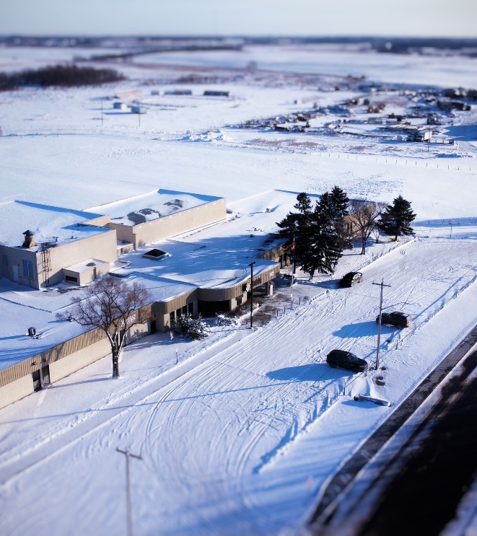
Library Service Framework #1
Access
        Albertans have access to information regardless of economic, social, or geographic circumstances.
Accountability
Provincial and municipal governments support public library service. Library boards are accountable to citizens and funders.
Notes:
There are four principles for equitable access to public library services in Alberta

Slide 9
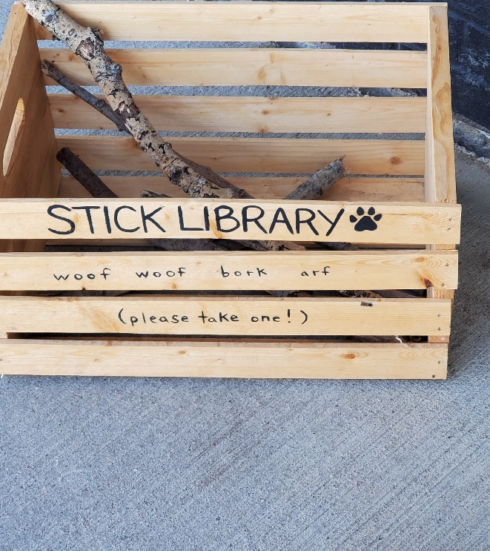
Library Service Framework #2
3. Service Efficiency and Effectiveness
Cooperation through library systems provides efficient access to services.
4. Funding
Library service is funded by local and provincial tax dollars. Library boards may NOT charge for basic library service.
Notes:
There are four principles for equitable access to public library services in Alberta
Basic library service is defined in the regulations. Access to the building, the right to use the collection in house, the right to ask for help – all examples of services that the Board cannot charge for.

Slide 10
Public Library Services #1
Collections and services are based on a needs assessment and plan of service.
Needs assessments are mandated within the Alberta Libraries Act.
Edit footer in the insert tab
9/3/2021
Notes:
Once established, the library board is a corporation with all the rights and responsibilities of a corporation.

Slide 11
Public Library Services #2
Welcoming, safe space open to all.
Physical and digital collections.
Wide array of programs and services both in person and virtual.
Edit footer in the insert tab
9/3/2021
Notes:
Once established, the library board is a corporation with all the rights and responsibilities of a corporation.

Slide 12
Public Library Services #3
Access to technology, including computers, WIFI, training and equipment lending.
Community hub.
Edit footer in the insert tab
9/3/2021

Slide 13
Public Library Services #4
Other services:
  Exam proctoring.
  Language learning.
  Homework help/tutoring.
  Job seeking supports.
  Room rentals.
  Document assistance (AISH, EI, certifications, resumes).
Edit footer in the insert tab
9/3/2021
Notes:
Other services may include the following. These are determined by the board in response to community needs

Slide 14
Regional Library System
A cooperative of municipalities working together to provide better level of local library service.
Together, they can accomplish more than any member could individually.
Notes:
Parkland oldest 1959 YRL second oldest (1971). All the rest through late 1980s and early 1990s.
Library System members receive library expertise, specialized products and services and IT infrastructure needed to provide 21st century library services to their communities.

Slide 15
Regional Library System Services #1
Professional expertise and tools for library management and operations.
Information technology (IT), infrastructure support.
Shared purchasing power.
Edit footer in the insert tab
9/3/2021
Notes:
Services are outlined by a master membership agreement – a legal agreement that outlines what services councils determined are needed and the rate that will be paid.
Enhancements to services are determined through needs assessments .

Slide 16
Regional Library System Services #2
Order, catalogue, and prepare materials for circulation.
Digital content including eBooks, eAudio, eMagazines and eNewspapers
Subscription databases.
Shared specialty collections.
Edit footer in the insert tab
9/3/2021
Notes:
Shared collections: storytime kits, makerspace kits, programming, STEAM resources.

Slide 17
Regional Library System Services #3
Sharing core library software (TRAC).
  Yellowhead, Marigold, Northern Lights, Peace.
Sharing eBooks and eAudiobooks.
  Cloudlibrary (TRAC, Parkland).
  OverDrive (TRAC, Parkland, EPL, CPL).
Edit footer in the insert tab
9/3/2021
Notes:
Results in improved service to patrons and cost efficiencies.

Slide 18
Regional Library System Services #4
Resource sharing: centralized resource sharing with access to collections across Canada.
Professional development and training.
Delivery service.
Edit footer in the insert tab
9/3/2021
Notes:
Results in improved service to patrons and cost efficiencies.

Slide 19
Regional Library System Services #5
Managed websites.
Assistance with advocacy, marketing, community consultation, service planning and assessment.
Trustee training.
Support to library boards and staff.
Edit footer in the insert tab
9/3/2021
Notes:
Results in improved service to patrons and cost efficiencies.

Slide 20
Provincial Government Role #1
Provides annual grants to municipal and library system boards.
Establishes guidelines for library services.
Facilitates province-wide sharing of public library resources.
Edit footer in the insert tab
9/3/2021
Notes:
Results in improved service to patrons and cost efficiencies.

Slide 21
Provincial Government Role #2
Funds library access to SuperNet.
Provides per capita funding for First Nations reservces and Metis Settlement residents to have equitable access to public library service.
Edit footer in the insert tab
9/3/2021
Notes:
Results in improved service to patrons and cost efficiencies.

Slide 22
Provincial Government Role #3
Funds access to resources for those with a print disability.
Funds government courier.
Licenses and funds some eContent.
Edit footer in the insert tab
9/3/2021
Notes:
Results in improved service to patrons and cost efficiencies.

Slide 23
Public Library Service Recap #1
Funded by municipal and provincial tax dollars.
Administered under/governed by Libraries Act and Regulations.
Managed independently by a council appointed board.
Edit footer in the insert tab
9/3/2021
Notes:
Results in improved service to patrons and cost efficiencies.

Slide 24
Public Library Service Recap #2
Rural municipalities benefit from library system membership to:
  Reduce urban-rural divide.
  Achieve cost-saving benefits.
  Meet public expectations for library service.
  Access expertise, support and resources unsustainable independently.
Edit footer in the insert tab
9/3/2021
Notes:
Results in improved service to patrons and cost efficiencies.

Slide 25
Questions?

